Slide 1
WOMEN’S POLITICAL PARTICIPATION AND LEADERSHIP ASSESSMENT: COLOMBIA
FINDINGS PRESENTATION
Date, 2023

Slide 2
AGENDA
Assessment Purpose & Approach
Methodology
Barriers & Opportunities
Recommendations

Slide 3
ASSESSMENT PURPOSE AND APPROACH
The study of women’s political leadership in Colombia investigated the barriers to and opportunities for expanding women’s participation and leadership in the political landscape.
It used the Women’s Political Participation and Leadership (WPPL) Assessment Framework to document women’s access to and power in politics along socio-cultural, institutional, and individual dimensions.
The assessment analyzed WPPL through the lenses of access and power.
USAID can use the report’s findings to identify priority areas in which its investments are likely to have the greatest impact.
Notes:
Provide brief background on the framework – highlighting what audience needs to know to follow presentation. Can abbreviate further if audience is assumed to be familiar.

Slide 4
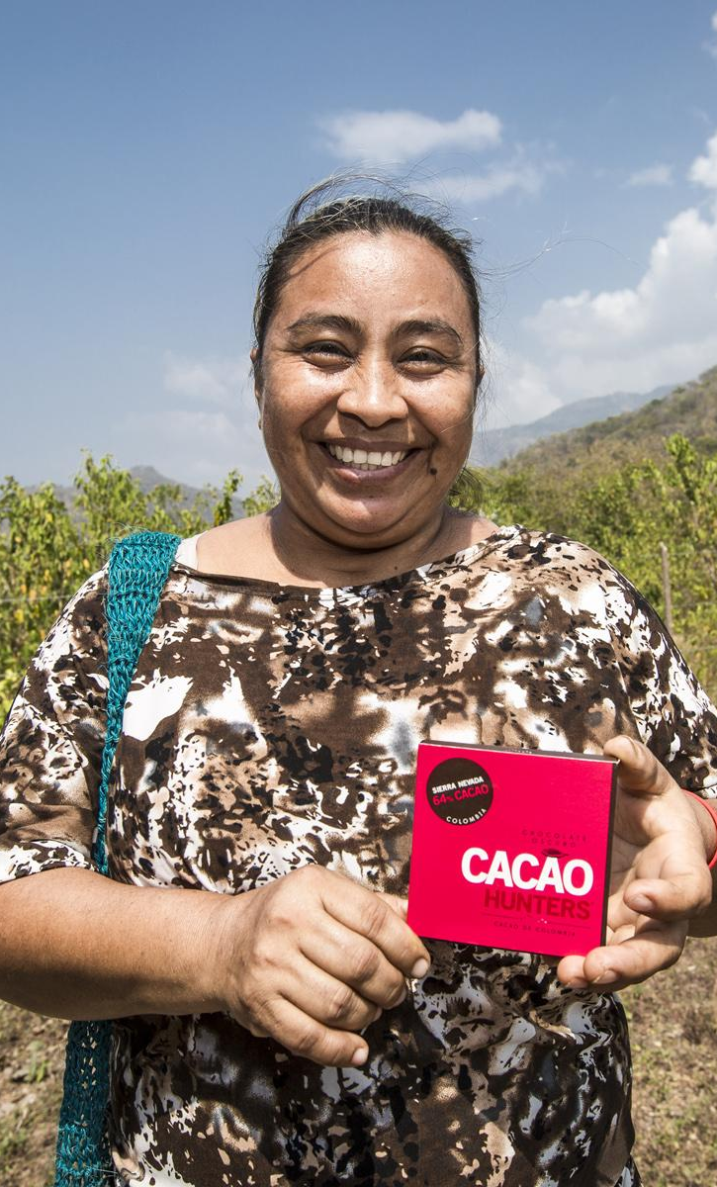
METHODOLOGY
Desk Review
Key Informant Interviews
Ten politicians (seven women, three men)
Four women donors and implementing partners
One man political leader
One woman electoral officer
Seven women WPPL experts
Two women government officials
One woman USAID/Embassy staff

Slide 5
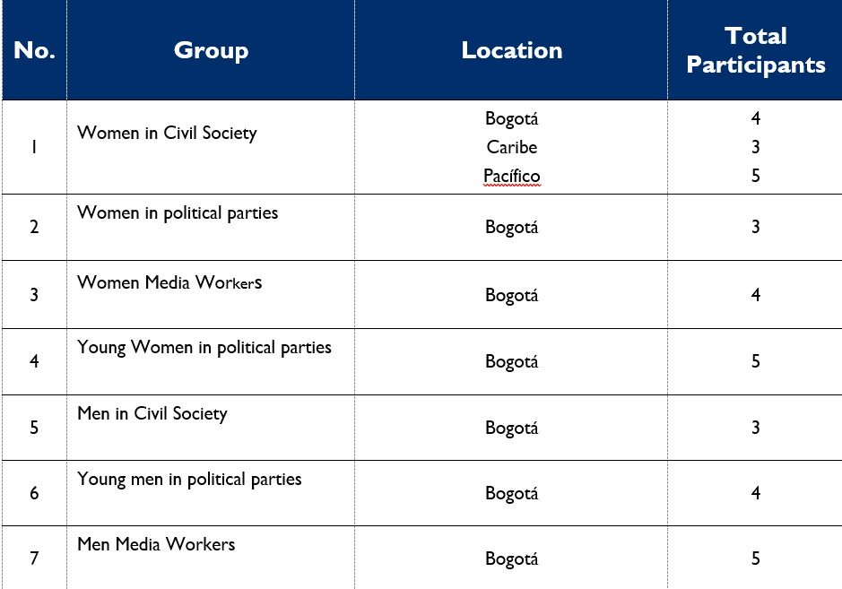
METHODOLOGY—FOCUS GROUP DISCUSSION

Slide 6
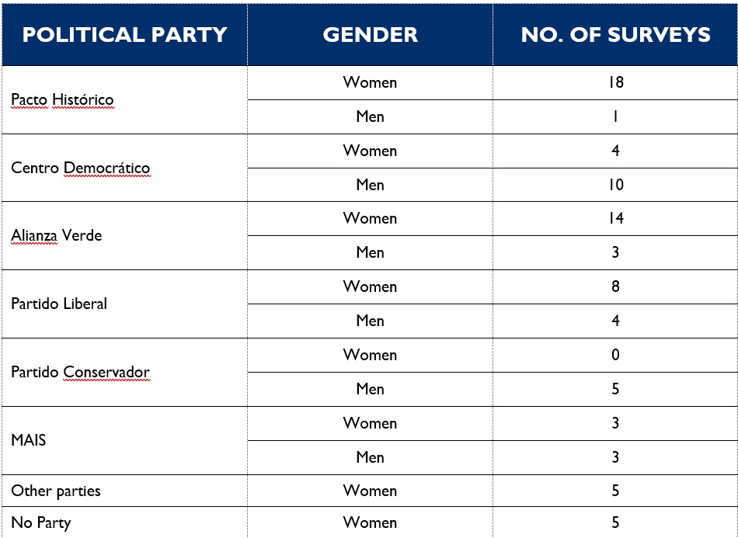
METHODOLOGY—SURVEY

Slide 7
BARRIERS & OPPORTUNITIES

Slide 8
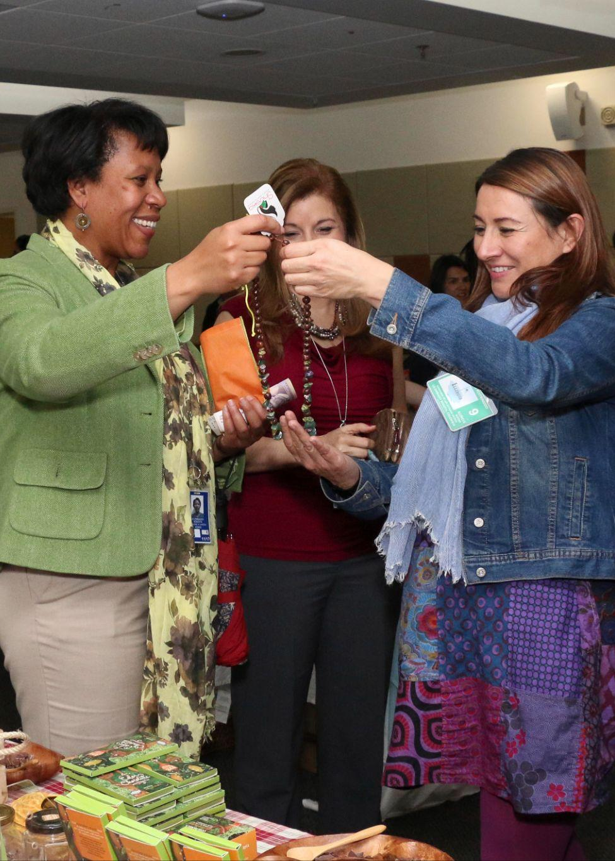
SOCIO-CULTURAL FACTORS
Barriers
Gender stereotypes
Violence against women in politics (VAWP) and electoral contexts
“Family voting”
Men politicians undermine WPPL
Opportunities

Slide 9
INSTITUTIONAL FACTORS
Barriers
Political parties
Opaque candidate selection process
Lack of women’s leadership
Women’s wings
Campaign finance
Differential needs of women in politics
Lack of women’s agenda and voice
Marginalized communities face additional barriers
Opportunities
VAWP law
Presidential Counselor’s Office for Women’s Equity
Women’s participation in peace process

Slide 10
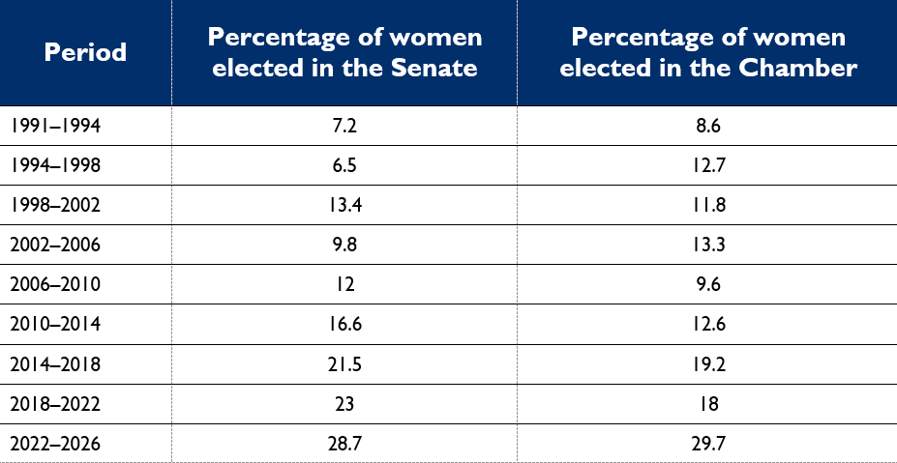
INDIVIDUAL FACTORS
Barriers
Differential effects on underrepresented communities
Inadequate candidate preparedness training
VAWP
Opportunities

Slide 11
SELECTED RECOMMENDATIONS

Slide 12
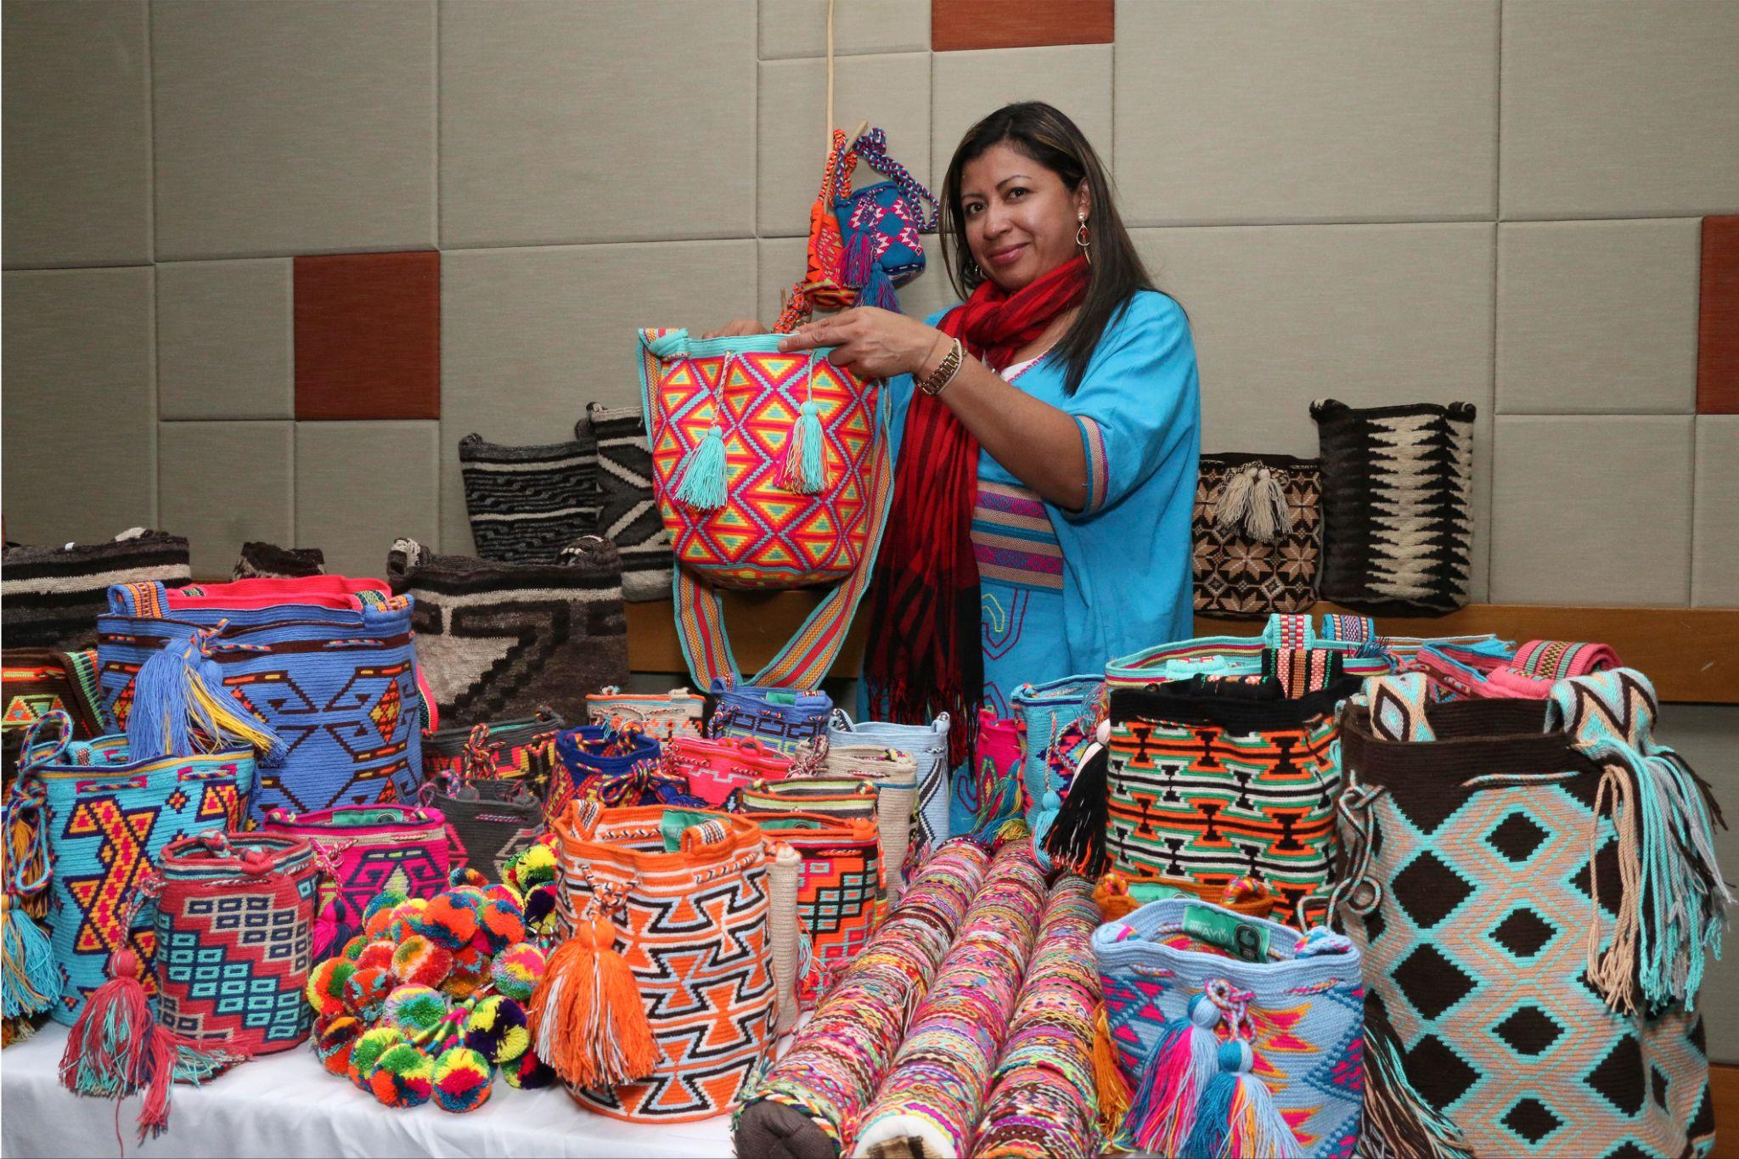
SOCIO-CULTURAL
Engage men gatekeepers and allies
Support WPPL public information campaigns
Conduct media training
“Women have become more empowered, but [participation] is still lacking because of the fear, the lack of guarantees for our security.”
-Focus group discussion participant, woman

Slide 13
INSTITUTIONAL
Electoral reform
Develop monitoring capacity
Increase women’s access to resources
Funding and technical support for civil society organizations
Women’s right to vote

Slide 14
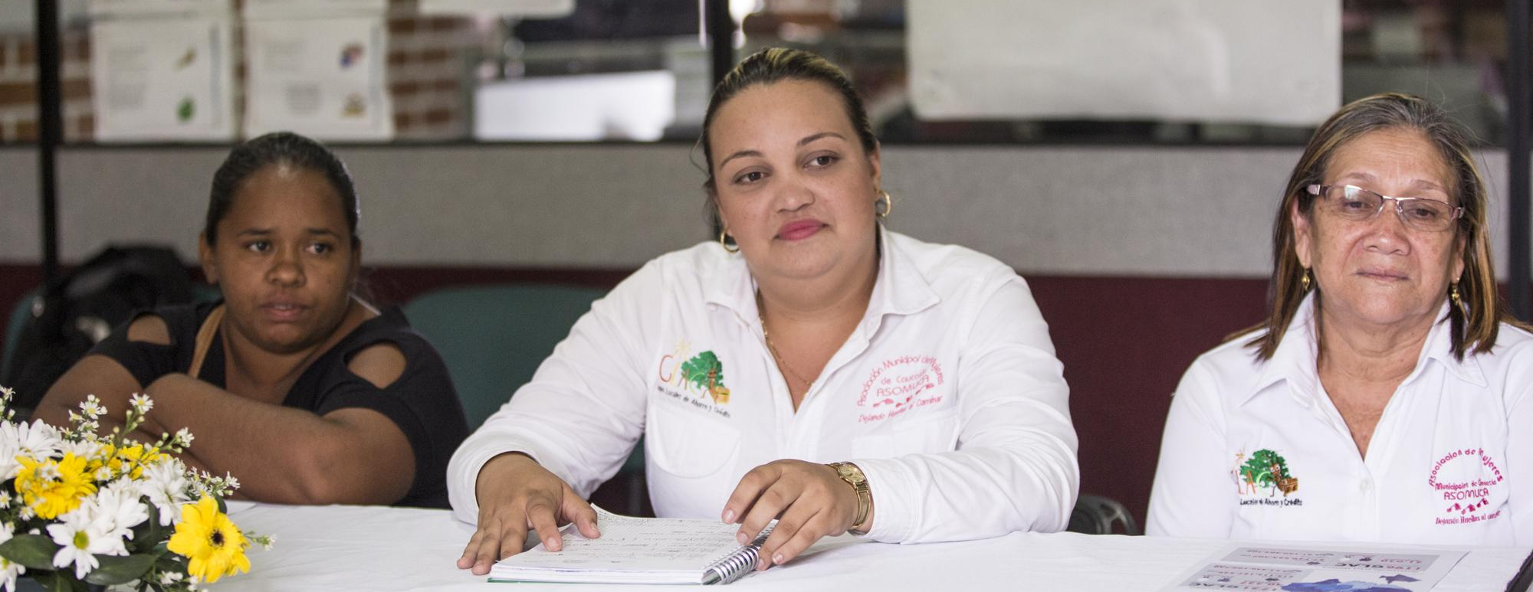
INDIVIDUAL
Civic education
Political preparedness training
Legal and psychological support

Slide 15
QUESTIONS?

